Slide 1

Hybrid Teaching Sharing
GU Zhan (Sam)
OVER
GRADUATE
PROGRAMME
ALUMNI
OFFERING OVER
TRAINING OVER
6,873
150
ENTERPRISE IT, INNOVATION
& LEADERSHIP PROGRAMMES
157,000
DIGITAL LEADERS
& PROFESSIONALS

Slide 2
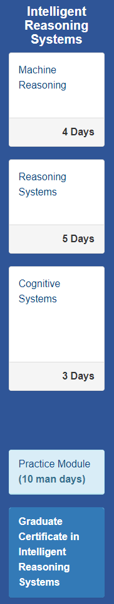
Class Run Information
Course: Machine Reasoning (4 days), a modular course under MTech Graduate Certificate: Intelligent Reasoning Systems (IRS), AI Practices
Lecturer: GU Zhan (Sam)
Course Admin: Angela CHUA
Run schedule: 4 Saturdays 9AM-5PM Singapore time zone, Jan-Feb 2022
Delivery Mode: Hybrid: F2F + Virtual Zoom
2

Slide 3
Class Run Information
Class Participants:
30 MTech part time thru-train learners, taking entire IRS Grad-Cert
23 Joined F2F class;
3 Joined specific Zoom sessions due to medical reasons;
4 Joined Zoom sessions from different time zones: Qatar (5 hours behind) & India (2.5 hours behind);
2 EEP learners, taking one Machine Reasoning course
1 Joined F2F class;
1 Joined specific Zoom sessions due to medical reasons;
3 Corporate learners, taking entire IRS Grad-Cert
1 joined F2F class;
2 joined Zoom sessions from different time zones: Qatar (5 hours behind);
Hybrid Delivery with on average 28 in F2F class & 7 in zoom
3

Slide 4
Class Run Information
Class Timing | Singapore | India | Qatar
Start | 9 am | 6:30 am | 4 am
Morning break | 10 am | 7:30 am | 5 am
Lunch | 12 pm | 9:30 am | 7 am | Breakfast for Qatar
Afternoon break | 3 pm | 12:30 pm | 10 am
End | 5 pm | 2:30 pm | 12 pm
4

Slide 5
Practices & Learnings
Use classroom PC as Zoom host, benefits:
AV equipment can be set up earlier and more stable: mic, projector, audio and stable internet; Extra web-camera connected to CR PC to show classroom view;
Consider to pin the classroom view in Zoom, making it always shown at top;
5

Slide 6
Practices & Learnings
Use lecturer own laptop to log in Zoom as co-host, benefits:
Share screen; laptop web-camera to show lecturer;
If the laptop web-cam has high resolution, then it can be used to aim at classroom whiteboard as well, accompanied by digital white board;
6

Slide 7
Practices & Learnings
Set up multiple microphones, benefits:
Multiple hand-held mic for F2F students to use;
Clip-on mic for lecturer;
Obtain a mic stand from IT for contingency;
7

Slide 8
Practices & Learnings
Set up a dedicated screen/monitor to show the remote/zoom learners to class and lecturer, benefits:
More engagements and liveness;
Easier for lecturer to notice zoom chats/questions;
Zoom by default can display about 5 zoom participants;
8

Slide 9
Practices & Learnings
Set up anonymous online Q&A session:
When class size >10, we observed more anonymous questions using online Q&A platform
When class size < 10, less /none anonymous question;
Live F2F questions & Zoom chat are still enabled; (most times, F2F learners will alert lecturer when there is a chat msg in zoom.)
9

Slide 10
Practices & Learnings
Good & effective practice: Course admin joins zoom during initial period of course on 1st day:
Help (new) learners to familiarize learning environment, e.g. attendance, LumiNUS matters;
Problem solving and coordination for audio/video issue in zoom;
Real time point of contact and support when lecturer is engaged with content delivery;
10

Slide 11
Practices & Learnings
Student buddy / Class group:
If feasible, appoint a F2F class ‘student buddy’ to join the zoom, who can also monito and assist remote learners;
Create class group in MS Teams (matriculated students) or WhatsApp (QR code group joining, hence no mobile number collection required)
11

Slide 12
Practices & Learnings
Provide a timetable of activities for learners to participate, e.g., exercise, presentations, brainstorming:
Especially designed to facilitate the remote learners engagement across different time zones (keep them awake);
Also serves as reminder for lecturer to invite remote learners to share and participate in class activities;
12

Slide 13
Practices & Learnings – Nice to have
Set up more camera to cover entire classroom if possible, methods:
Wide angle / Fish eye lens;
Use extra computers/mobiles in Zoom to enable more camera;
Set up more handheld microphones in classroom:
E.g. one mic every 10 students;
Set up extra monitor/screen to display remote learners:
Larger LCD/Monitor; Also helps in highlighting zoom chat / questions.
Existing dual-Projectors in some classrooms: one to project lecture content, one for displaying remote learners;
13

Slide 14

Practices & Learnings
Any question or experience sharing from you?
Teaching Excellence Team & Resources
Several points above are also recommended by Teaching Excellence team’s Hybrid teaching guide:
https://nusu.sharepoint.com/sites/ISS_Intranet_Teaching_Excellence/SitePages/Hybrid-Teaching-Guide(1).aspx
14

Slide 15
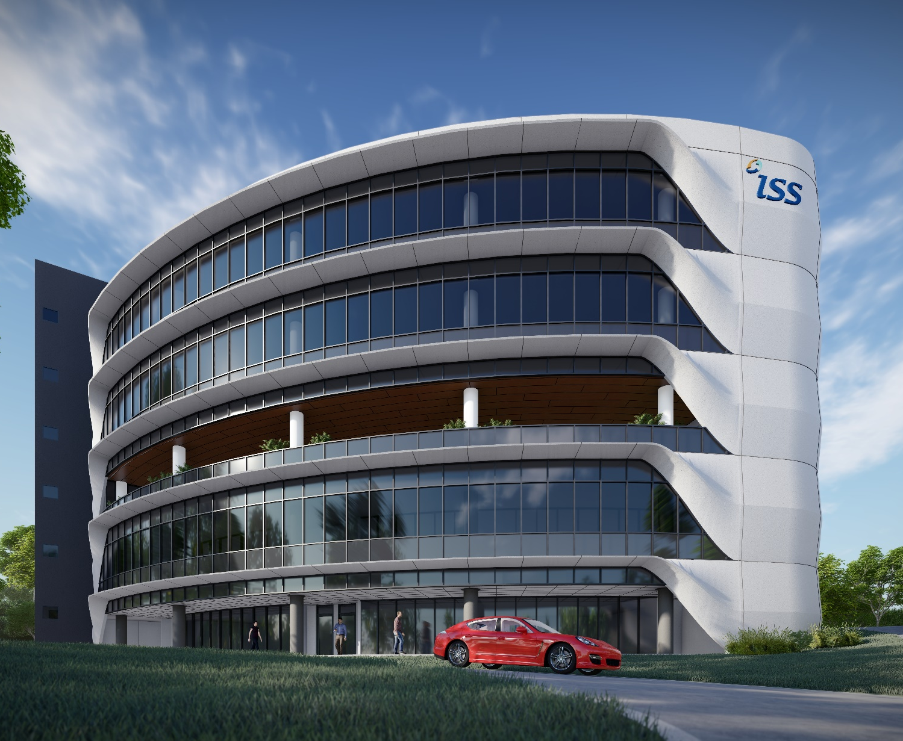






www
www.iss.nus.edu.sg
www.facebook.com/ISS.NUS
twitter.com/ISSNUS
@iss.nus
www.linkedin.com/company/iss_nus
youtube.com/user/TheISSNUS/
15

Slide 16
End

